Slide 1
Introduction to Soft Computing
By
Varun Deshmukh
Assistant Professor,
Department of Computer Engineering,
MPSTME, Shirpur Campus

Slide 2
INTRODUCTION TO SOFT COMPUTING
Concept of computation
Hard computing
Soft computing
How soft computing?
Hard computing vs. Soft computing
Hybrid computing

Slide 3
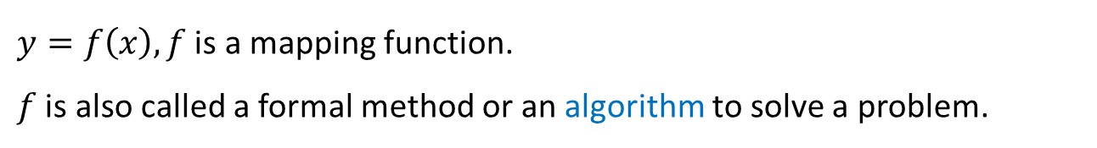
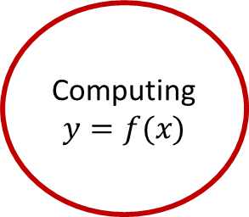
CONCEPT OF COMPUTATION
Computing
$$y=f(x)$$
Antecedent
Consequent
Control Action
Figure: Basic of computing
$y=f\left(x\right), f$ is a mapping function.
$f$ is also called a formal method or an algorithm to solve a problem.

Slide 4
Important characteristics of computing
Should provide precise solution.
Control action should ne unambiguous and accurate.
Suitable for problem, which is easy to model mathematically.

Slide 5
Hard computing
In 1996, L. A. Zade (LAZ) introduced the term hard computing.
According to LAZ: We term a computing as Hard computing, if
Precise result is guaranteed.
Control action is unambiguous.
Control action is formally defined (i.e., with mathematical model or algorithm).

Slide 6
Examples of hard computing
Solving numerical problems (e.g., roots of polynomials, integration, etc.).
Searching and sorting techniques.
Solving computational geometry problems (e.g., shortest tour in a graph, finding closet pair of points given a set of points, etc.).
many more…

Slide 7
Soft computing
The term soft computing was proposed by the inventor of fuzzy logic, Lotfi A. Zadeh. He describes it as follows.
Definition 1: Soft computing
Soft computing is a collection of methodologies that aim to exploit the tolerance for imprecision and uncertainty to achieve tractability, robustness, and low solution cost. Its principal constituents are fuzzy logic, neuro-computing, and probabilistic reasoning. The role model for soft computing is the human mind.

Slide 8
Soft computing
Zadeh defined soft computing into one multidisciplinary system as the fusion of the fields of Fuzzy logic, Neuro-computing, Evolutionary and Genetic computing, and Probabilistic computing.
Soft computing is the fusion of methodologies designed to model and enable solutions to real world problems, which are not modelled or too difficult to model mathematically.
The aim of soft computing is to exploit the tolerance for imprecision, uncertainty, approximate reasoning, and partial truth in order to achieve close resemblance with human like decision making.

Slide 9
Goals of Soft computing
Soft computing is a new multidisciplinary field, to construct new generation of artificial intelligence, known as computational intelligence.
The main goal of soft computing is to develop intelligence machines to provide solutions to real world problems, which are not modelled, or too difficult to model mathematically.
Its aim is to exploit the tolerance for Approximation, uncertainty, Imprecision, and partial truth in order to achieve close resemblance with human like decision making.
Approximation: here the model features are similar to the real ones, but not the same.
Uncertainty: here we are not sure that the features of the model are the same as that of entity.
Imprecision: here the model features are not the same as that of the real ones, but close to them.

Slide 10
Characteristics of soft computing
It does not require any mathematical modeling of problem solving.
It may not yield the precise solution.
Algorithms are adaptive (i.e., it can adjust to the change of dynamic environment).
Use some biological inspired methodologies such as genetics, evolution, Ant’s behaviors, particles swarming, human nervous system, etc.).

Slide 11
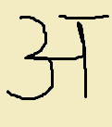
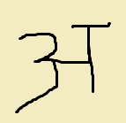

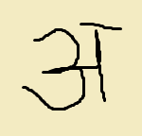

Examples of soft computing
Soft computing
$$⋮$$
Example: Hand written character recognition (Artificial Neural Networks)

Slide 12





Examples of soft computing
Soft computing
Bank with maximum return
$$⋮$$
Example: Money allocation problem
(Evolutionary Computing)

Slide 13
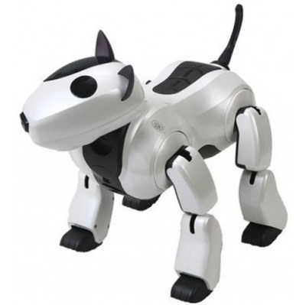
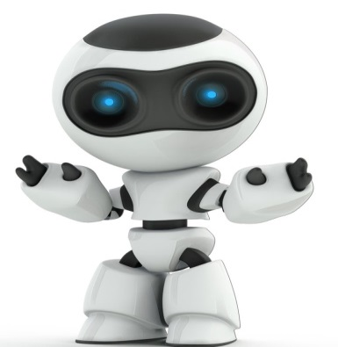
Examples of soft computing
Example: Robot movement
(Fuzzy Logic)

Slide 14
How soft computing?
How a student learns from his teacher?
Teacher asks questions and tell the answers then.
Teacher puts questions and hints answers and asks whether the answers are correct or not.
Student thus learn a topic and store in his memory.
Based on the knowledge he solves new problems.
This is the way how human brain works.
Based on this concept Artificial Neural Network is used to solve problems.

Slide 15
How soft computing?
How world selects the best?
It starts with a population (random).
Reproduces another population (next generation).
Rank the population and selects the superior individuals.
Genetic algorithm is based on this natural phenomena.
Population is synonymous to solutions.
Selection of superior solution is synonymous to exploring the optimal solution.

Slide 17
How soft computing?
How a doctor treats his patient?
Doctor asks the patient about suffering.
Doctor find the symptoms of diseases.
Doctor prescribed tests and medicines.
This is exactly the way Fuzzy Logic works.
Symptoms are correlated with diseases with uncertainty .
Doctor prescribes tests/medicines fuzzily.

Slide 18
Hard computing vs. Soft computing
Hard computing | Soft computing
It requires a precisely stated analytical model and often a lot of computation time. | It is tolerant of imprecision, uncertainty, partial truth, and approximation.
It is based on binary logic, crisp systems, numerical analysis and crisp software. | It is based on fuzzy logic, neural nets and probabilistic reasoning.
It has the characteristics of precision and categoricity. | It has the characteristics of approximation and dispositionality.

Slide 19
Hard computing vs. Soft computing
Hard computing | Soft computing
It is deterministic. | It incorporates stochasticity.
It requires exact input data. | It can deal with ambiguous and noisy data.
It is strictly sequential. | It allows parallel computations.
It produces precise answers. | It can yield approximate answers

Slide 20
Hybrid computing
It is a combination of the conventional hard computing and emerging soft computing.
HC
SC
Hybrid computing
Figure: Concept of Hybrid Computing

Slide 21
In this course…
You will be able to learn
How to build an artificial neural network and train it with input data to solve a number of problems, which are not possible to solve with hard computing.
Basic concepts of Fuzzy algebra and then how to solve problems using Fuzzy logic.
The framework of Genetic algorithm and solving varieties of optimization problems.

Slide 22
Text Books
1.Jack M. Zurada, “Introduction to Artificial Neural Network Systems”, Jaico Publishing House, 2006
2. Timothy J. Ross, “Fuzzy Logic with Engineering Application”, Wiley, 2004.
3. S. Rajasekaran, G.A. Vijayalakshmi Pai, “Neural Networks, Fuzzy Logic and Genetic Algorithms Synthesis and Applications”, PHI 2003.

Slide 23
Reference Books:
1. Simon Haykin, “Neural Networks” , PHI, 2002
2. Samir Roy, Udit Chakraborty, “Introduction to Soft Computing Neuro-Fuzzy and Genetic Algorithms”, Pearson 2013
3. S. Rajasekaran, G. A. Vijaylakshmi Pai , “Neural Network, Fuzzy Logic & Genetic Algorithms Synthesis & Application”, PHI, 2005
4. S. N. Shivanandan, S. Sumathi & S. N. Deepa, “Introduction to Neural Networks using matlab 6.0”, McGraw Hill Education, 2006.

